Slide 1
COMPUTER NETWORKING
IPv4 & IPv6
Understanding Internet Protocols:
Addressing, Architecture & the Road Ahead
Suraj Kumar Jha | NCIT, Pokhara University

Slide 2
WHY THIS TOPIC MATTERS
4.3B
340
Undecillion
45%+
Total IPv4
Addresses
IPv6 Address
Space
Global IPv6
Adoption
All exhausted by 2011
Essentially unlimited
Google stats, 2024
The internet is running out of IPv4 addresses — IPv6 is not optional, it's inevitable.

Slide 3
What is IPv4?
Introduced in
1981 (RFC 791)
Address Breakdown
192
168
1
1
Address Size
32-bit
8 bits
8 bits
8 bits
8 bits
Format
Dotted Decimal
= 32 bits total
Example
192.168.1.1
Address Classes
Class A: 0.0.0.0 – 127.x.x.x
Total Addresses
~4.3 Billion
Class B: 128.0.0.0 – 191.x.x.x
Header Size
20–60 bytes (variable)
Class C: 192.0.0.0 – 223.x.x.x
D/E: Multicast / Research

Slide 4
IPv4 Header Structure
Version
(4 bits)
IHL
(4 bits)
Type of Service
(8 bits)
Total Length
(16 bits)
Identification (16 bits)
Flags
(3)
Fragment Offset (13 bits)
TTL
(8 bits)
Protocol
(8 bits)
Header Checksum (16 bits)
Source IP Address (32 bits)
Destination IP Address (32 bits)
Key Fields:
TTL — Prevents infinite loops | Protocol — TCP=6, UDP=17 | Flags/Offset — Control fragmentation

Slide 5

Limitations of IPv4
Address Exhaustion
No Built-in Security
IANA ran out of IPv4 blocks in February 2011. Regional registries have followed. NAT is a workaround — not a solution.
IPsec is optional in IPv4. Packets can be spoofed, intercepted, or modified without end-to-end encryption by default.
NAT Complexity
Variable Header / Fragmentation
Network Address Translation breaks end-to-end connectivity, complicates peer-to-peer apps, and adds processing overhead.
Routers must fragment packets, adding overhead. Options field makes the header variable-length, slowing routing.

Slide 6
What is IPv6?
Introduced in
1998 (RFC 2460)
Address Breakdown
2001
0db8
0000
0000
Address Size
128-bit
Format
Colon-Hex Notation
0000
0000
0000
0001
Example
2001:0db8::1
8 groups × 16 bits = 128 bits
Total Addresses
340 Undecillion
Key Improvements Over IPv4
Mandatory IPsec
Header Size
40 bytes (fixed)
Auto-configuration (SLAAC)
No NAT needed
Multicast (no broadcast)
Simplified routing

Slide 7
IPv6 Header Structure
Version
(4 bits)
Traffic Class
(8 bits)
Flow Label
(20 bits)
Payload Length (16 bits)
Next Header
(8 bits)
Hop Limit
(8 bits)
Source Address (128 bits)
Destination Address (128 bits)
IPv6 vs IPv4 Header — Key Simplifications
Fixed 40-byte header (no IHL field needed) No Header Checksum (handled by upper layers)
No Fragmentation at routers (done at source) Extension Headers replace IPv4 Options

Slide 8
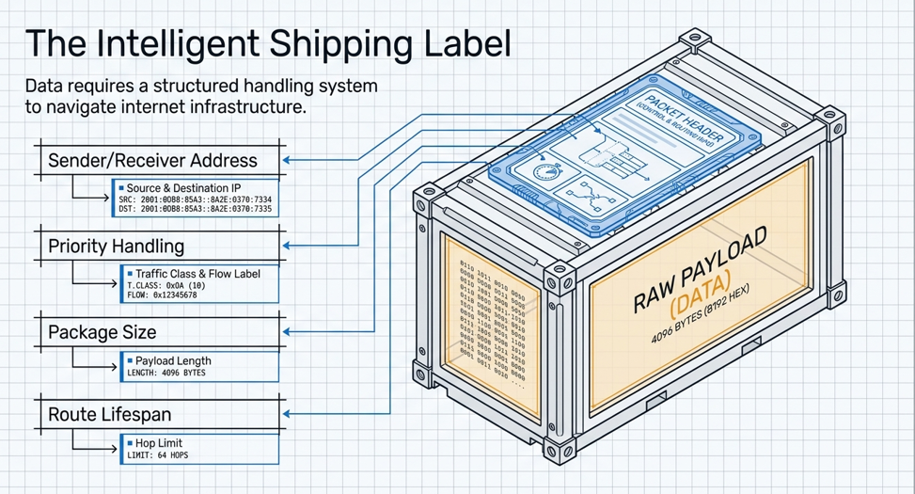

Slide 9
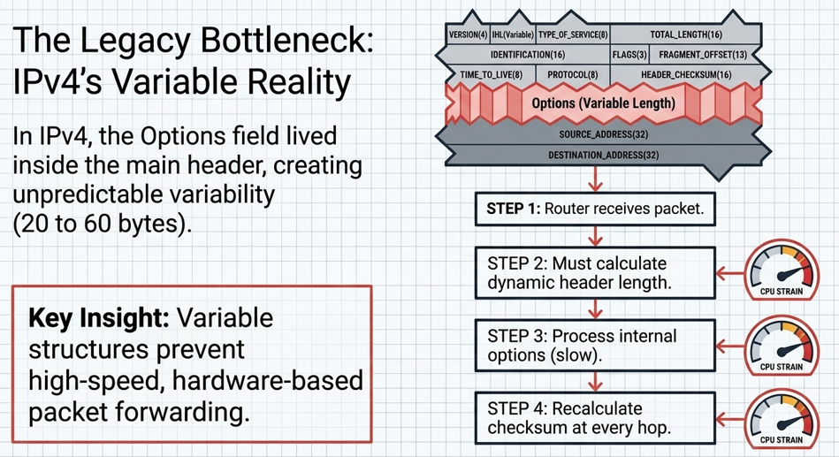

Slide 10
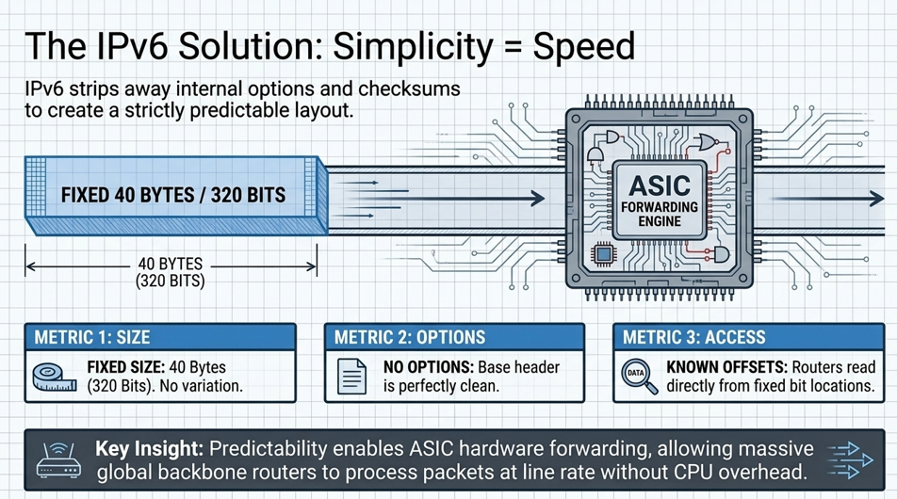

Slide 11
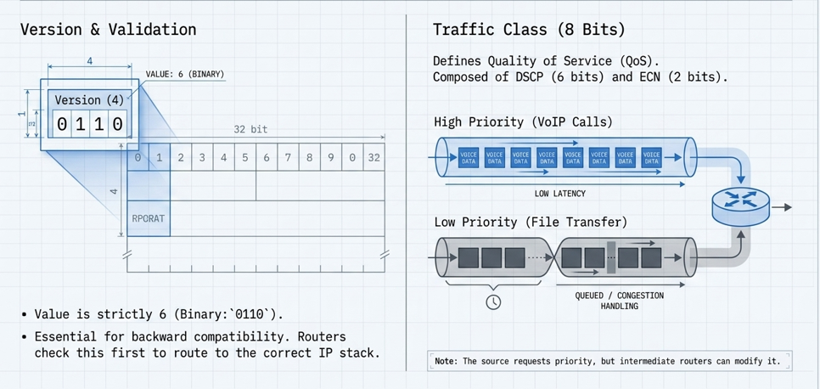

Slide 12
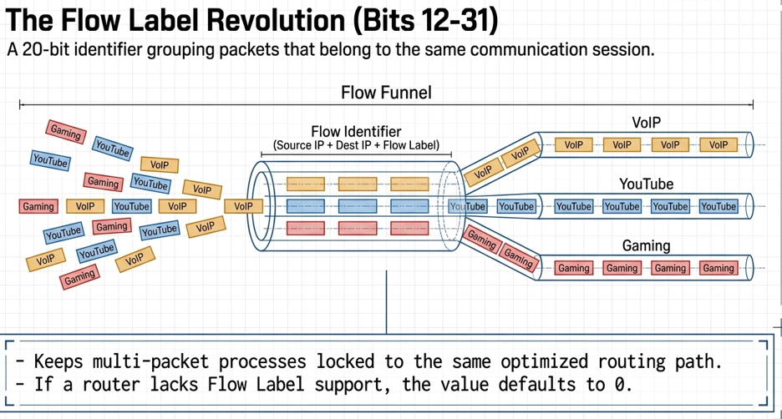

Slide 13
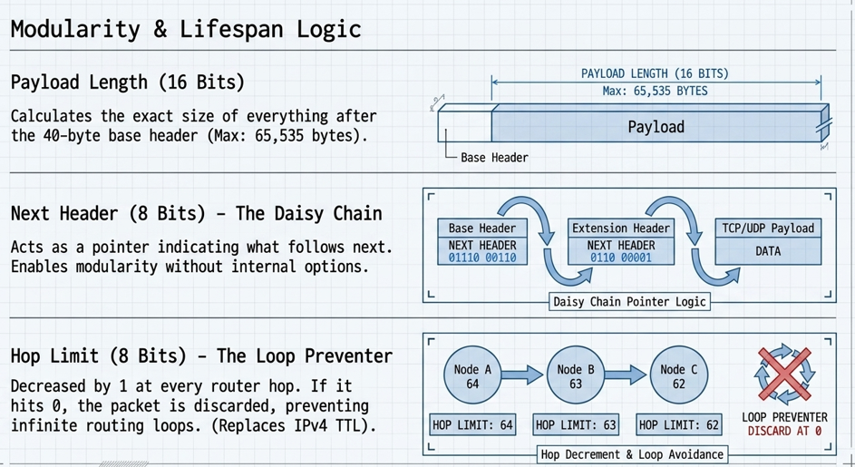

Slide 14
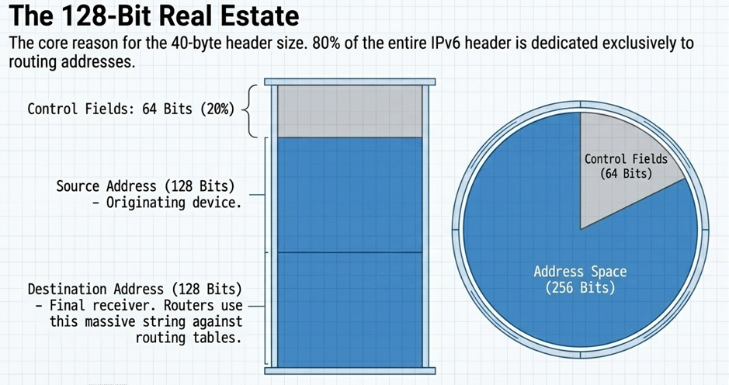

Slide 15
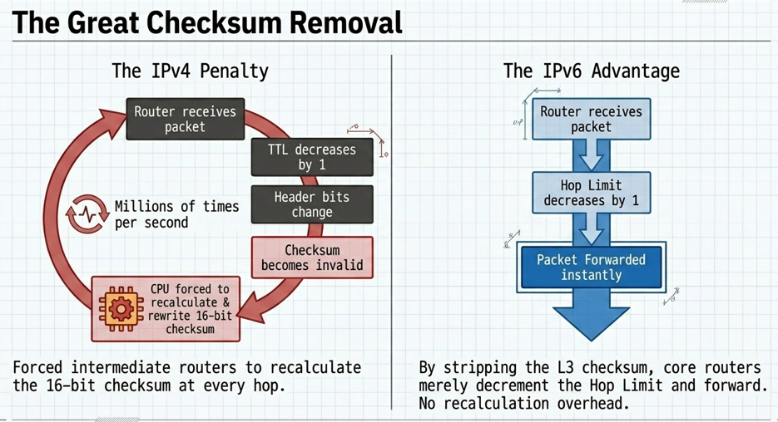

Slide 16
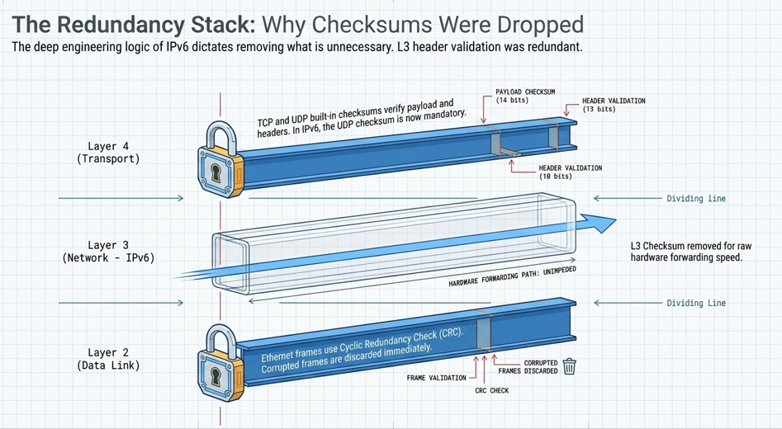

Slide 17
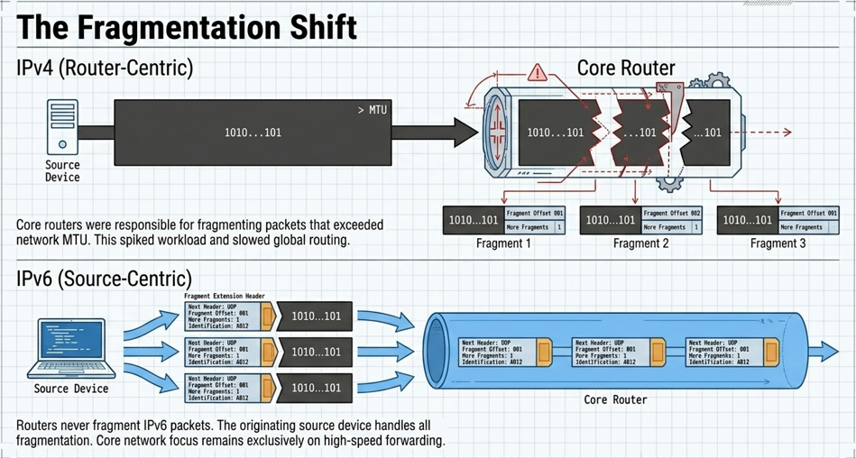

Slide 18
IPv4 vs IPv6 — Side by Side
Feature
IPv4
IPv6
Address Length
32 bits
128 bits
Address Format
Dotted Decimal
Colon Hexadecimal
Total Addresses
~4.3 Billion
340 Undecillion
Header Size
20–60 bytes (variable)
40 bytes (fixed)
Header Checksum
Yes
No (removed)
IPsec Support
Optional
Mandatory
Fragmentation
Routers & Source
Source only
Broadcast
Supported
Replaced by Multicast
NAT Required
Yes (address shortage)
No (vast address space)
Auto-configuration
DHCP (manual)
SLAAC (automatic)

Slide 19
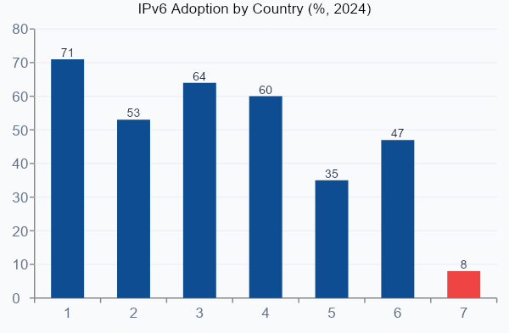
IPv6 Adoption — Real World
45%+
Global Average
71%
India (highest)
8%
Nepal (growing)
2011
IANA IPv4 Exhaustion
Source: Google IPv6 Statistics, APNIC Labs, 2024

Slide 20




Key Takeaways
IPv4's 32-bit space is exhausted — ~4.3B addresses were not enough for the modern internet.
IPv6's 128-bit addressing solves this permanently with 340 undecillion unique addresses.
IPv6 improves security (mandatory IPsec), simplifies headers, and eliminates NAT.
Transition is gradual — Dual Stack, Tunneling, and NAT-PT bridge the two worlds.
Global adoption is rising (~45%), but many regions like Nepal are still in early stages.
"IPv6 is not the future — it's the present."

Slide 21
Thank You &
Questions?
References
RFC 791 — Internet Protocol (IPv4), IETF, 1981
RFC 2460 — Internet Protocol Version 6, IETF, 1998
RFC 4291 — IPv6 Addressing Architecture
Google IPv6 Statistics — https://www.google.com/intl/en/ipv6/statistics.html
CN Lecture Notes — Yogesh Deo, NCIT

